Slide 1
#1259 Code Team Getting Started
December 2023

Slide 2






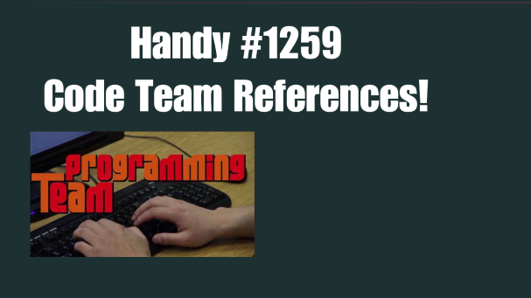
#1259 CODE TEAM Getting Started
This deck summarizes the introductory materials presented by Mr. Coursin to kick off the Team #1259 coding activities; especially focused on providing new students with a solid foundation of programming concepts.
Click each section to quickly navigate

Slide 3
Student Project#1: a LIGHT introduction to Arduinos & C++ Coding

Slide 4
Student Project: a LIGHT introduction to Arduinos & C++ Coding
Purpose: Provide a simple hands-on exercise to introduce students to the fundamentals of coding; enabling them to see first-hand how instructions (code) are created, then
translated into physical action to be taken by a computer or robot (in this case a basic light show display via a matrix of 9 addressable LED light strips that have been connected to an Arduino processing board).
The concepts learned in this project parallel (on a simpler scale) what they will learn & experience when coding the team’s robot, providing the instructions to meet the game requirements. It also provides an opportunity to learn & practice important coding skills such as keyboarding, understanding basic programming structure and syntax, and the importance of a logical problem-solving mindset when developing / debugging code.
01
02
03
04
05
06
ADVANCE PREP:
Update the Laptops
Create the LED Light sets
Connect the Lights to the Arduinos
BASIC CONCEPTS
Introduction to Arduinos
Digital Vs Analog
Order of logic processing
CODING TIME
Anatomy of a sketch
Create your sketch
Practice coding while learning basic structure / syntax
COMPILE / VERIFY
Checking your code for errors
Generating the binary output file
The art of debugging
SEND
Final check for accuracy and completeness
Uploading the executable file to the Arduino
ENJOY
Light Show!

Slide 5
ADVANCE PREP: Prepare the hardware
01
These steps can be performed by mentors and students in advance of the coding introduction.
Step 1.1
Step 1.2
Step 1.3
Update the Laptops
Assemble the LED Light sets
Connect LED Light Strip Set to the Arduinos
Log onto laptops & connect to internet
Install any pending Microsoft updates, if prompted
Update Arduino IDE to latest version
Website: Software | Arduino
Click “Windows MSI Installer “
Click “Just Download”
Click “Just Download” again
Launch the installer msi file from the laptops Download folder
Refine Arduino IDE Workspace
Set Dark Mode (File → References → Light to Dark)
Select Board: “Arduino Uno”
Type: “Nano”
Check under tools menu, confirm processor 328P
Instructions are for each “set” of lights
Cut 3 strips of individually addressable LED strip lights, each with 3 lights
Cut approx. 2” jumper wires for each light set & strip ends off each wire
2 green, 2 black, 2 red
Tape light strips parallel to each other (forming a 3 x 3 matrix) on a solderable surface (such as scrap wood)
Cut approx. 4” pigtail wires for each light set & strip ends off each wire
1 green, 1 black, 1 red
Solder wires to the light strips as shown in the schematic on the next page
Use flux (applied via small paintbrush) to aide in the soldering process
Using a small screwdriver, attach the pigtail wires into the Arduino board using the schematic on the next page
Loosen the screw
Insert the wire
Tighten the screw
Attach a Mini USB wire to the Arduino board
Warning: There is a risk of burning out the board if you stay plugged into your laptop’s USB port without dimming the light level as you will learn in this coding exercise

Slide 6
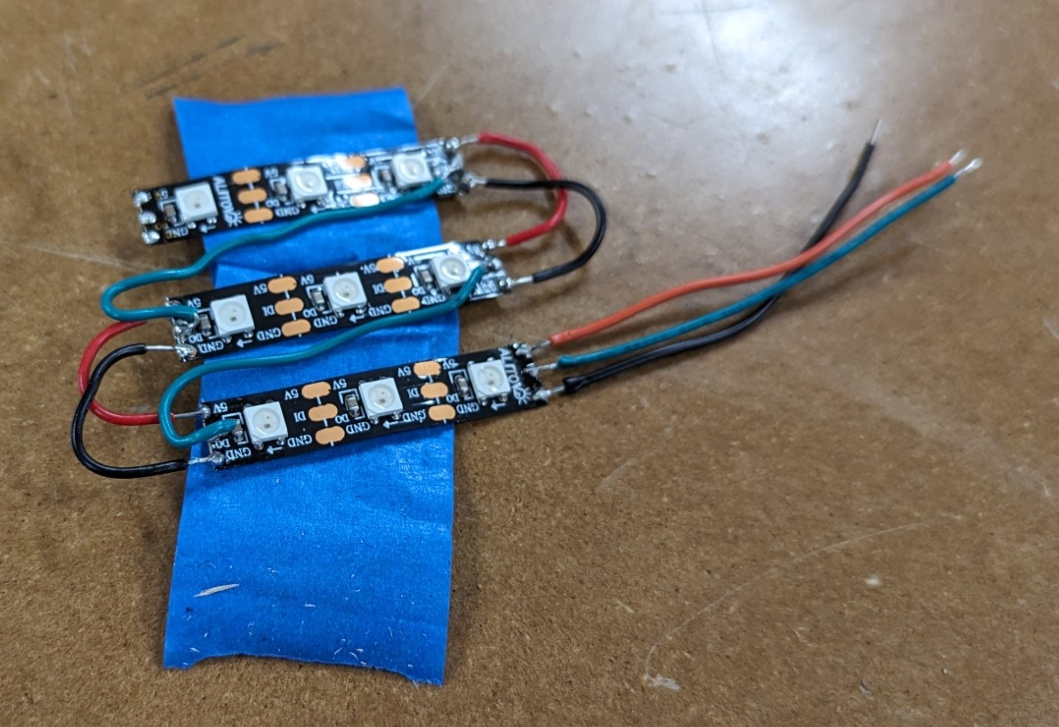
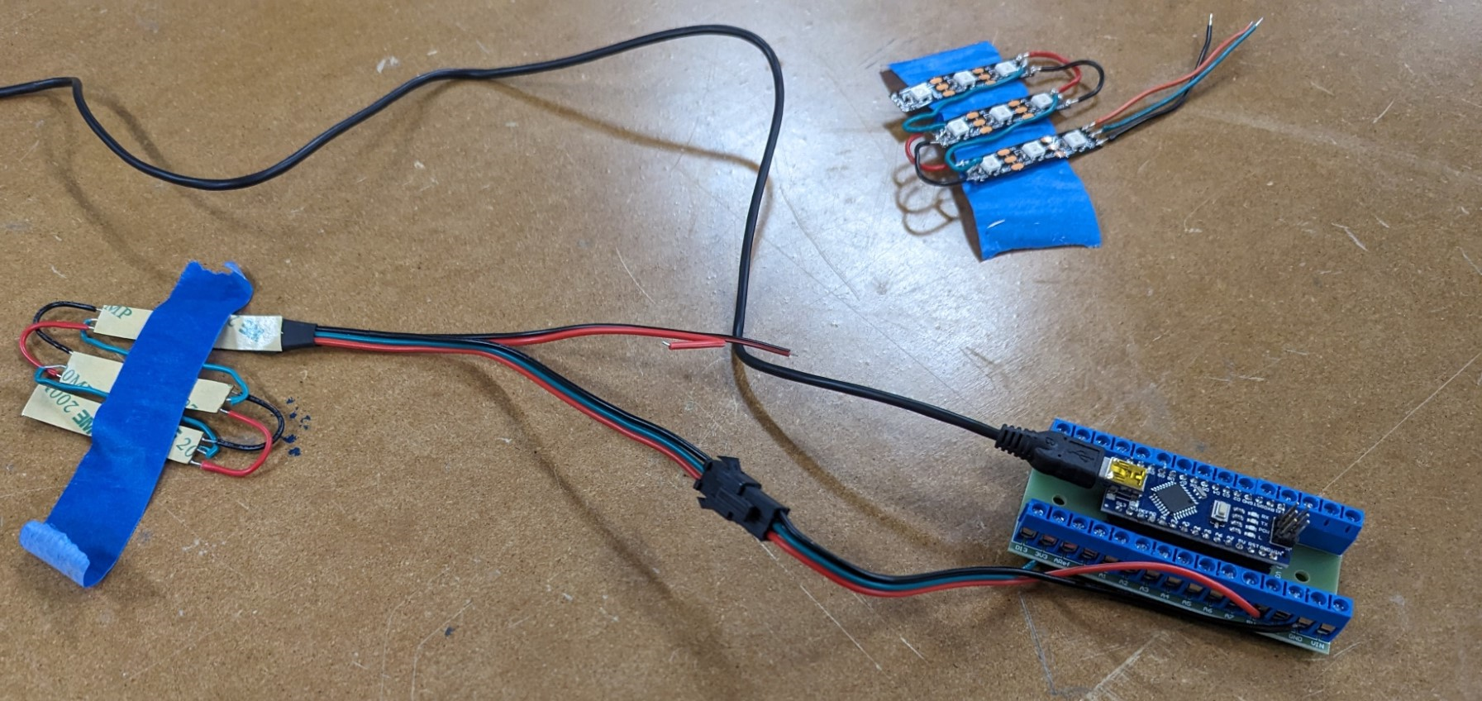
ADVANCE PREP: Prepare the hardware (Wiring Schematics)
01
These steps can be performed by mentors and students in advance of the coding introduction.
Step 2: Schematic
Step 3: Schematic
Assemble the LED Light sets
Connect LED Light Strip Set to the Arduinos
Wire the Ground
Wire the Power
Wire the Signal (Digital Output #6)
Use a Mini-USB cord to hook the Arduino to the laptop

Slide 7
SOME BASIC CONCEPTS
02
What is the Goal of Project #1?
Different Coding Languages have Different Rules & Quirks
Consistent Terminology Promotes Better
Collaboration & Efficiency!
Learn the basic!
Work on keyboard skills!
Coding is more geared towards typing than mouse navigations
Hands-on is best way to learn coding syntax (structure/format/punction & general quirks) of how to tell a computer what to do.
Computers are VERY literal and picky on syntax; and the rules differ between different languages.
C++
REQUIRES a semicolon (;) at the end of EACH line
Forgetting it can add hours to debugging!
Uses curly brackets {} to indicate the scope of a function
Difference operators and expressions than Python (such as && vs AND or ! vs NOT)
Python
Does note use semicolons to mark end of line
Uses white space & indentions to indicate the scope of a function
Has a much broader definition of data types that resolve to Boolean false
While certain objects may have different legitimate names, our agreement on which name WE use will reduce confusion
FUNCTION rather than Routine or Method
VARIABLE rather than Parameter = Argument
# POUND rather than Hash
( ) BRACKETS rather than Parenthesis or Braces
< > ANGLE BRACKETS rather than Greater Than, Less Than
/ \ Forward Slash and Back Slash
/* SLASH STAR rather than asterisk
x

Slide 8

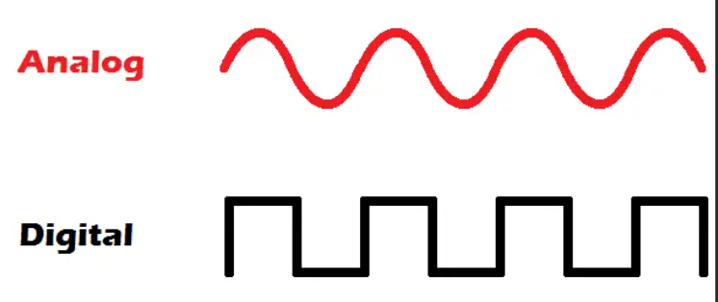
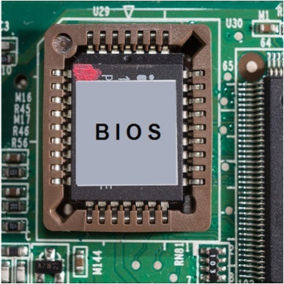
SOME BASIC CONCEPTS
02
Why use Arduinos to simulate robot computers?
Digital Vs Analog Signals
Order of Logic Processing:
“What runs first when you turn your computer on ?”
BIOS (Basic Input & Output System)
Initializes the hardware, then loads the Operating System (OS) and then other programs
Is burned on a memory chip (prebuilt for use!)
Setup() Functions
Only runs once per powerup
Initializes and sets the initial values for things that don’t change (like which pins are inputs vs outputs)
Loop() Functions
Do precisely what their name suggests, and loops consecutively, allowing your program to change and respond. Use it to actively control the Arduino board.
Small & Cheap! but still simulates how a larger computer would work
Provides bare bones functionality that demonstrates at the most basic level how instructions (code) can be created on a laptop, then sent to the processor of a robot or other computer (such as an Arduino) to then drive action from lights or other mechanics
Arduino files are actually C++ so great introduction to coding
Analog = Waves
Digital = On or Off
Represented as zeros or ones
Binary

Slide 9
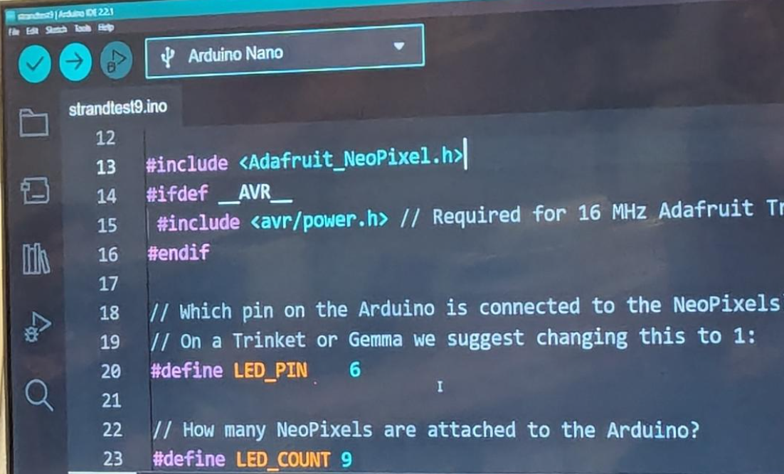
CODING TIME: Anatomy of a Sketch
03
Opening COMMENTS, ignored by computer, useful to subsequent human readers ☺
Step 3.1
// My first program in C++
// Created by: Bob Smith
// Last Updated: 12/10/2023
#include <iostream>
#define MyItem_1 5
#define MyItem_2 6
int main ()
{
Statement 1";
Statement 2;
}
Name of the HEADER file that contains definitions of files that are needed by this code
Review basic structure (anatomy) of a basic C++ program
Blank rows ignored; but improve legibility
DECLARATION section – lets you name and then predefine values for variables that will be used often
Syntax (including punctuation) is very important
Important to know what types of things to put where in the code structure
Code contains the computer instructions + enough documentation(comments) for future users
Initializes a function named ‘main’
Opening Curly Bracket
BODY of the function ‘main()’ being defined. All statements within the body should be indented for legibility, and each one MUST be terminated with a semicolon
Step 3.2
Closing Curly Bracket
Create your own copy of the sample program!
Open Arduino IDE
Create new file via: <FILE> → <New Sketch>
Creates a code file with *.ino file extension
Replicate the code from this sample program (‘StrangTest9.ino’)
Type it in– do NOT copy paste
Practice your keyboarding skills!

Slide 10

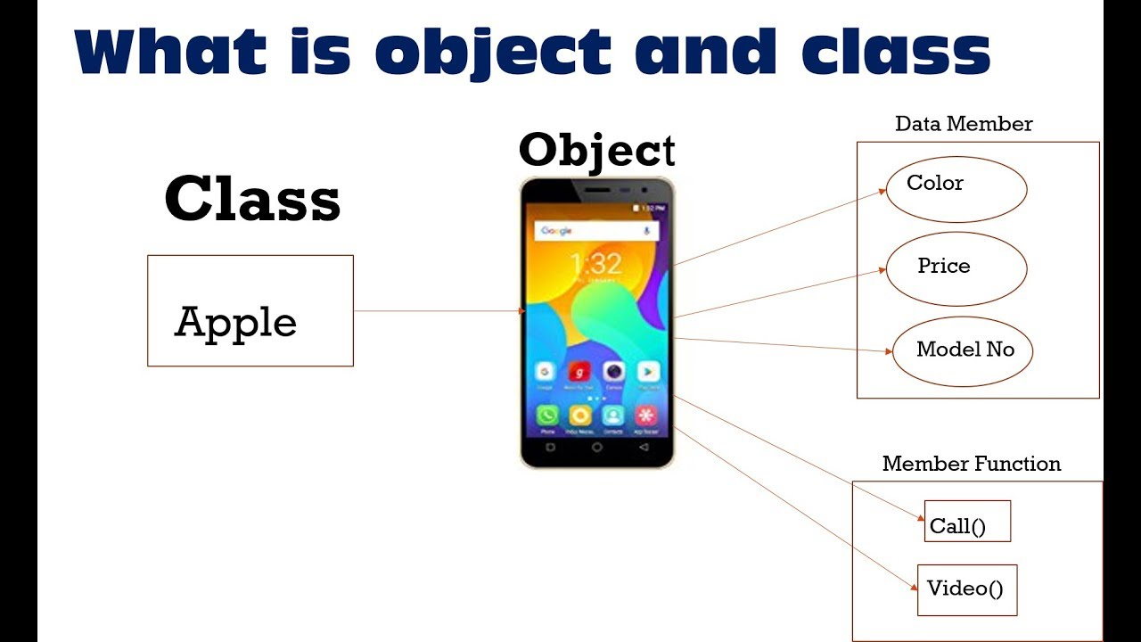
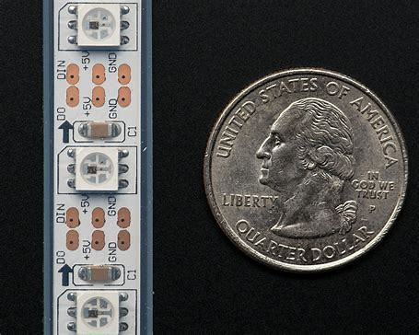
CODING TIME: Anatomy of a Sketch Part 2
03
Class
Step 3.2 (Continued)
Adafruit_NeoPixel
Object
NeoPixel
Strip
Create your own copy of the sample program!
Cell Phones
Data Member
/ Attributes
Replicate the code in the sample program (commenting out sections is you want to run one function at a time)
Comment out lines you want the computer to ignore by prefixing with //
Some of the highlights we discussed have been highlighted for you on these next pages →
Save file (Locally or eventually within GitHub repository)
NumbPixels
PIN
NEL_GRB
Member
Functions
/ Methods
Begin
Show
SetPixelColor
Fill
SetBrightness
Classes often represent broad categories of items that share different variations of similar attributes (such as ‘cell phones’). It’s a basic blueprint (or template) for all objects of that class.
Classes define what attributes an instance of this type of object will have, like phone model number, or case color, or price) but will not predefine the value of those attributes in advance for a specific object.
Classes can also contain methods or functions; the basic organizational structure of how to tell the objects how to do something they can do (like make audio calls, or record video).

Slide 11
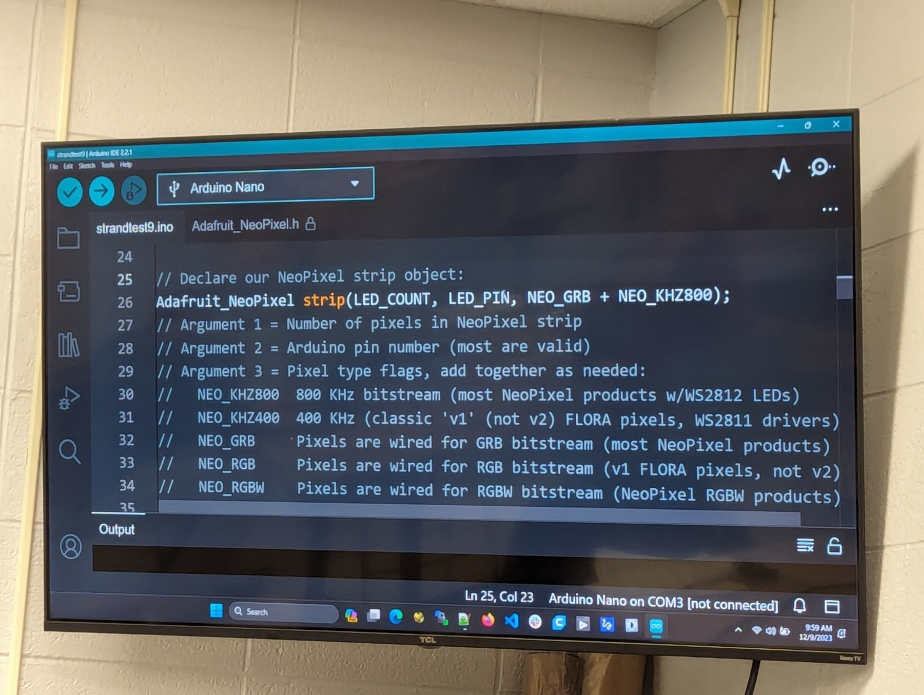
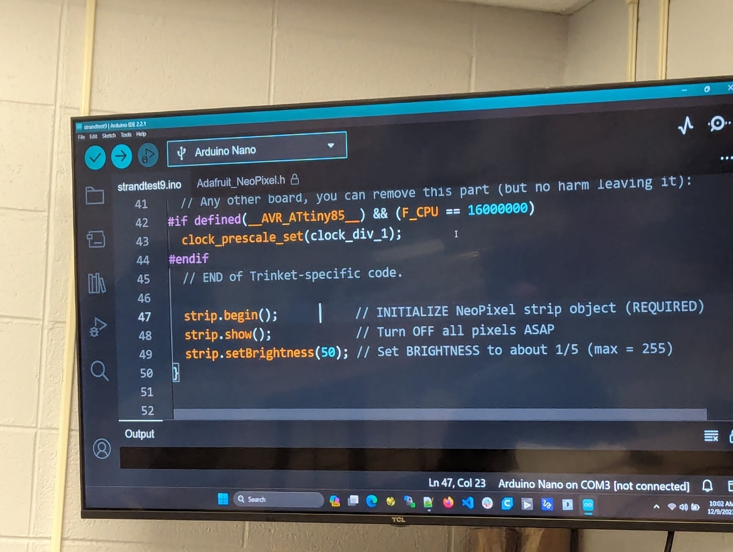
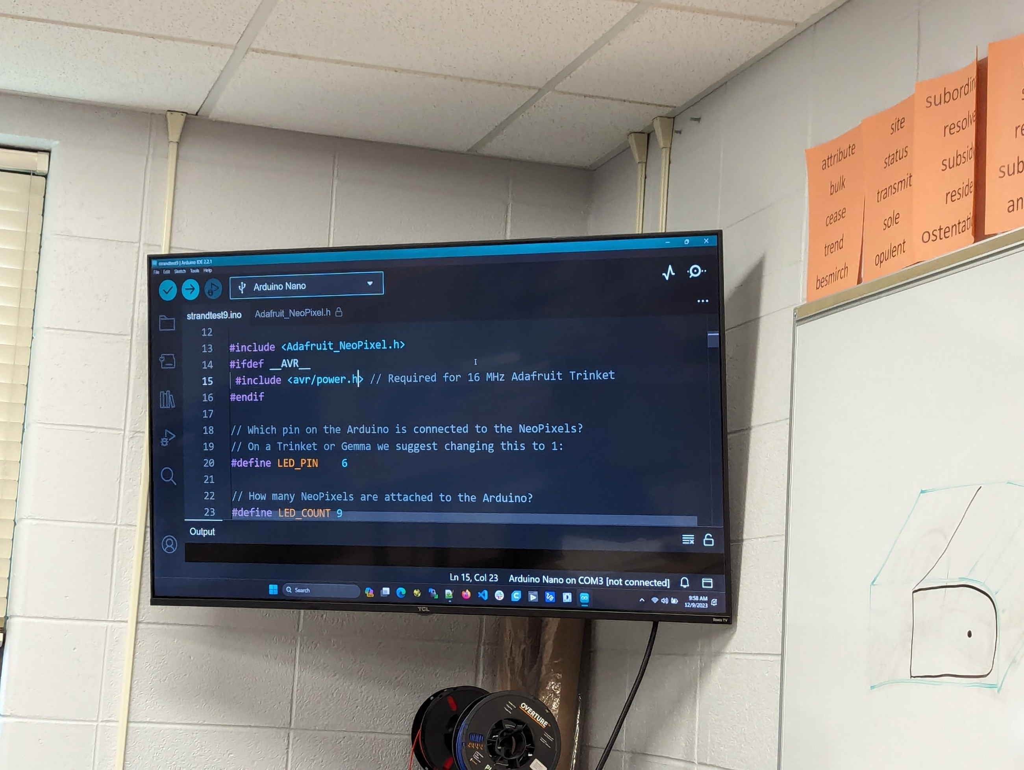
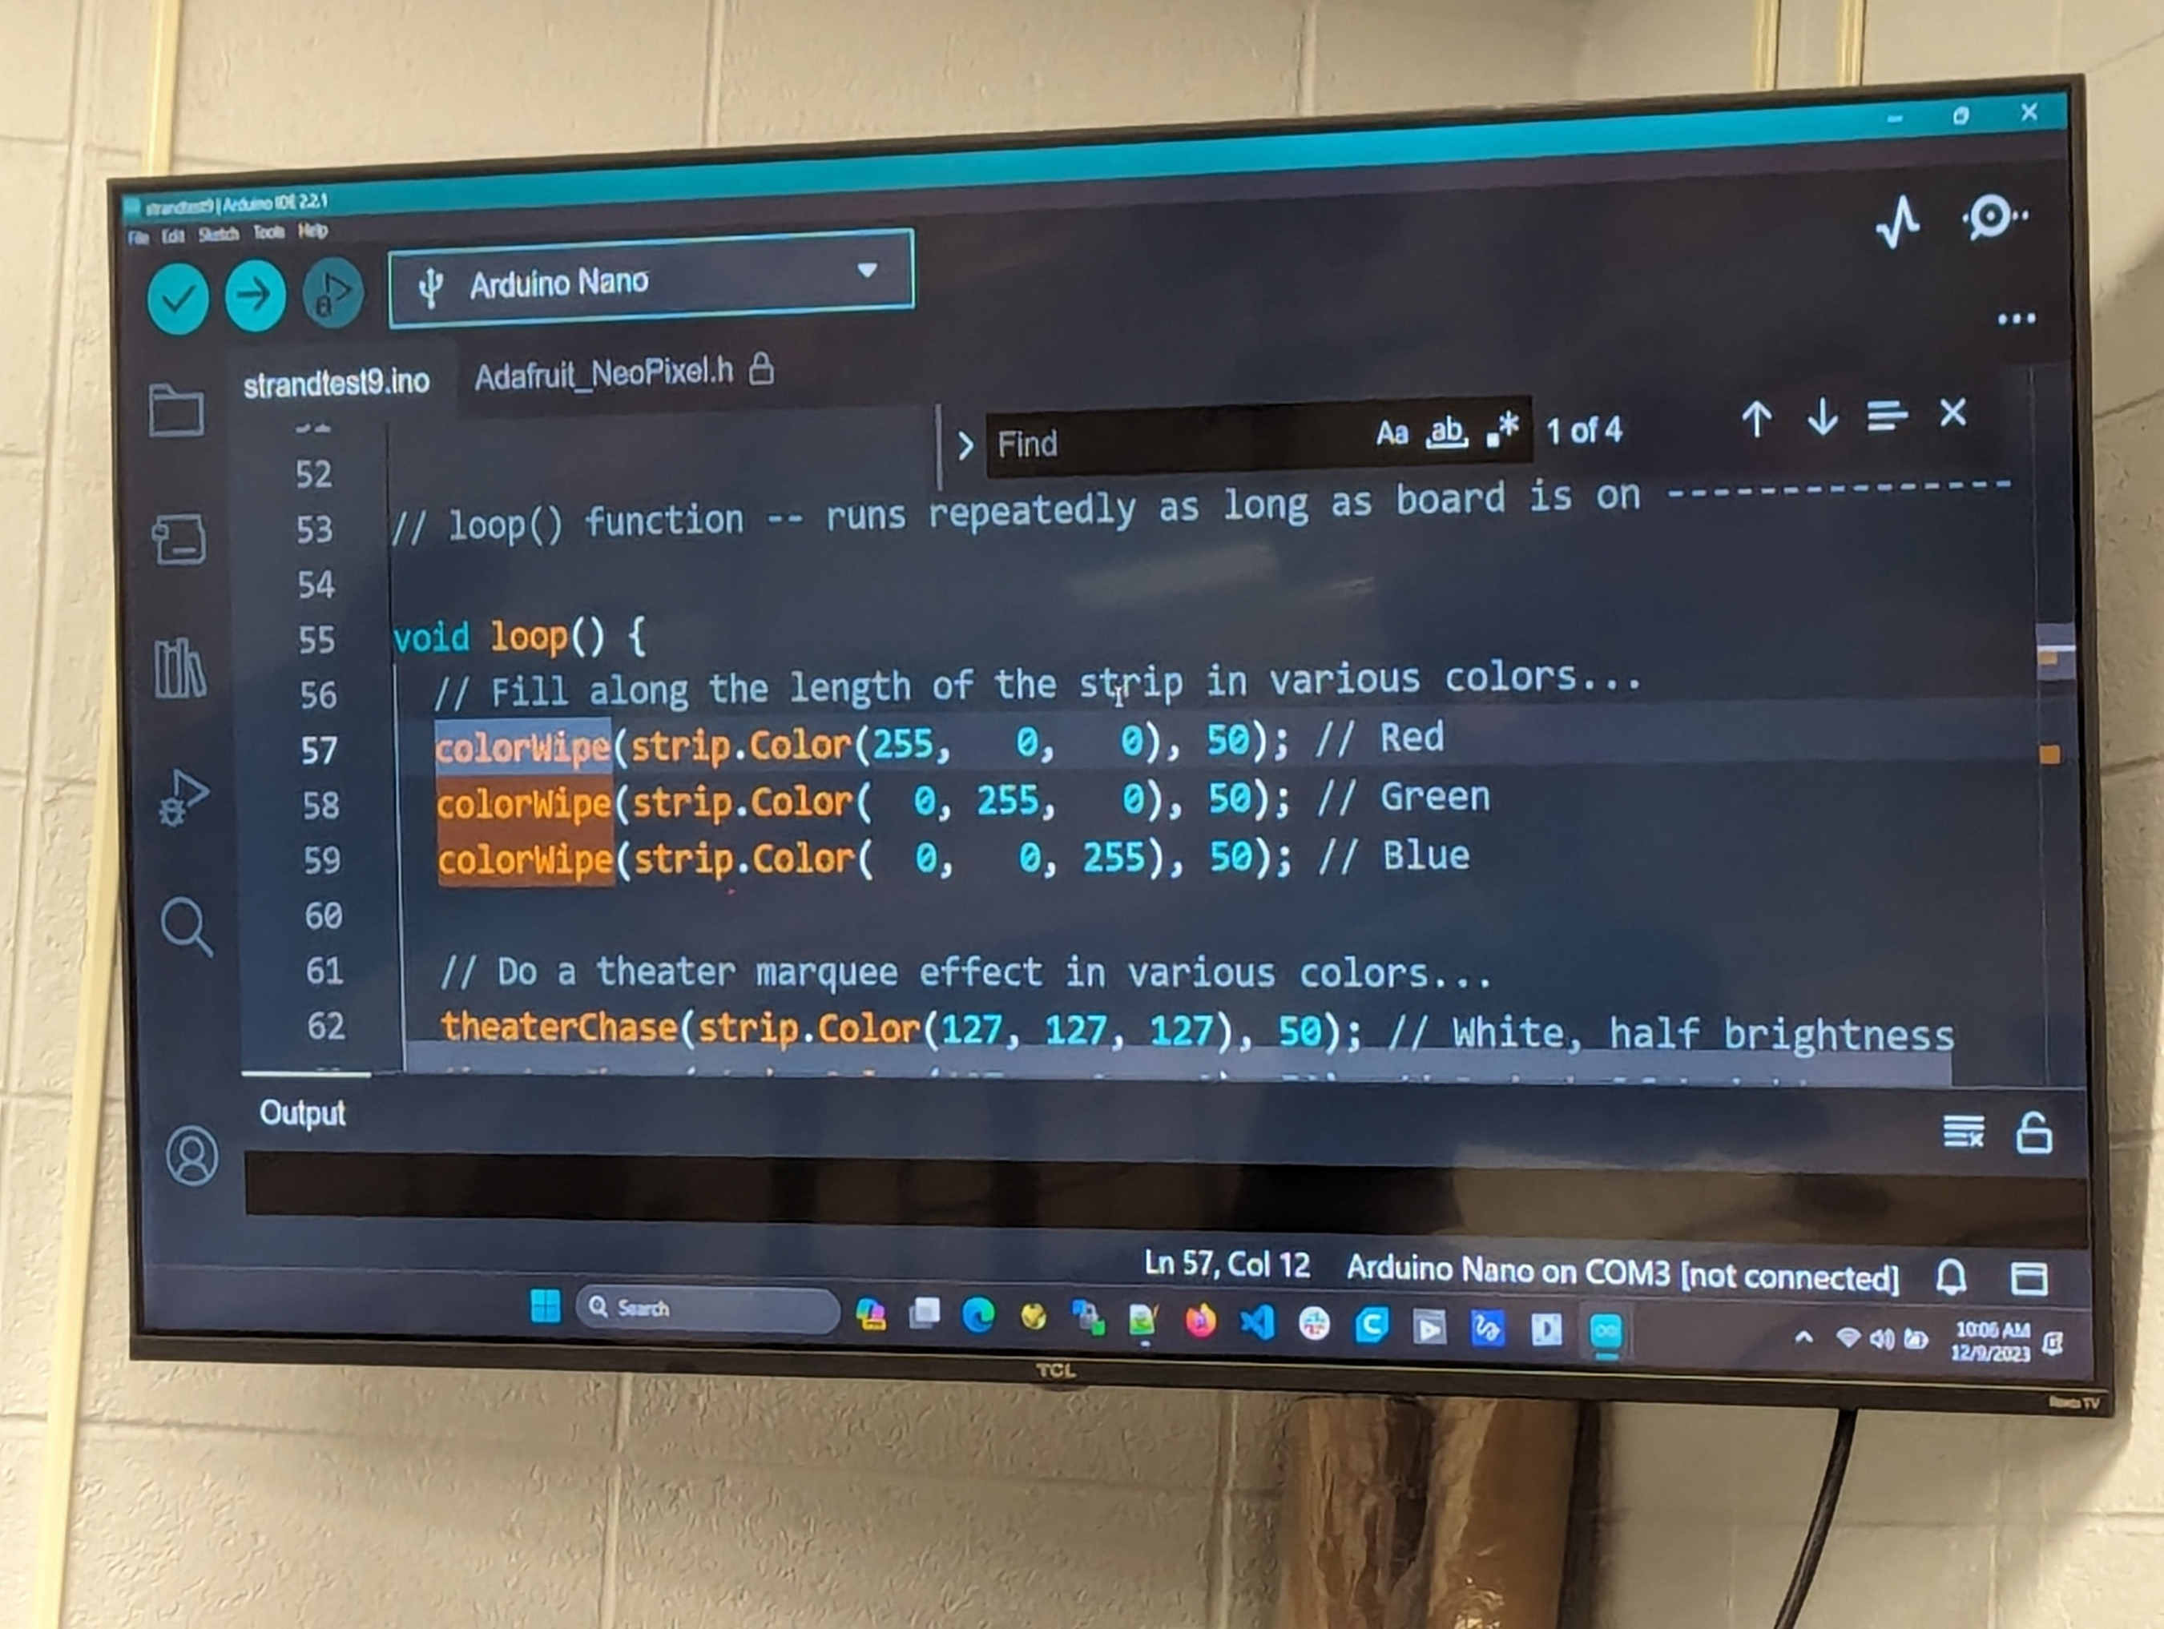
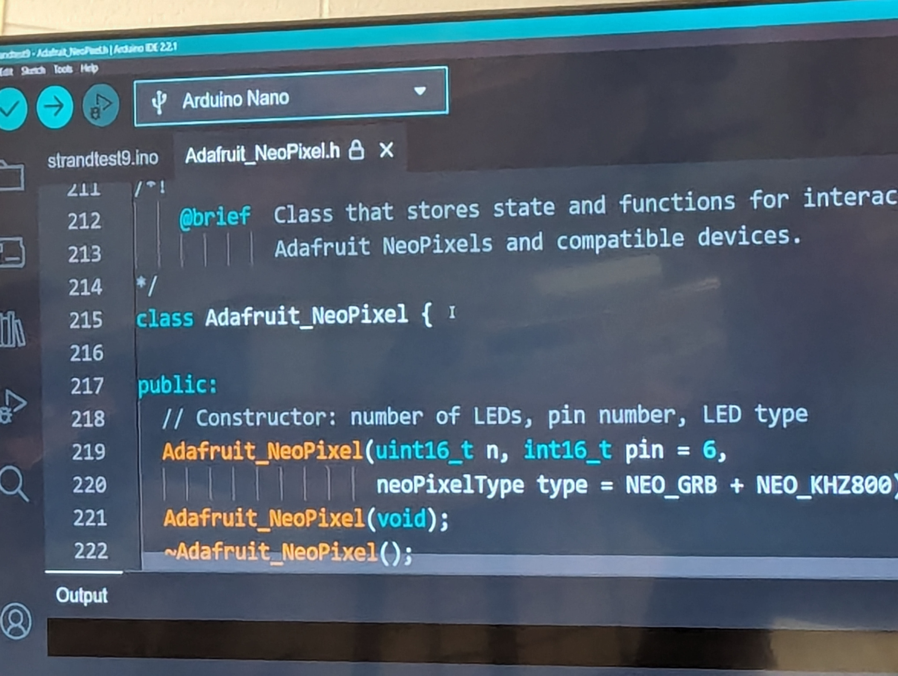
CODING TIME: Anatomy of a Sketch Part 3
03
First declare the Object And its Type
Adafruit_NeoPixel Strip
Then declare its arguments
(Comma delimited list of variables or parameters)
Step 3.2 (Continued)
Comment rows (ignored)
Create your own copy of the sample program!
Some more lessons
LED_COUNT (# of lights on our strip))
NEO_RGB - in this case GRB (as that is the order (Green Red Blue) for our strip; And its running at 800KZ to Green wire signals at 800 times a milisec
Note: You would only need to change that 800mz if using old hardware that couldn't handle this
strip.begin () = calls the object named strip
The empty brackets () means no parameters to pass
LED_PIN (the #)
Variables can be predefined as a Constant value; makes it much easier to control & change from this one constant location
strip.setBrightness(50) = sets brightness to 50%
Runs Loop() repeatedly as long as board is on (consisting of all code between this set of curly brackets)
Uint = unsigned integer, 16 bit
Call colorWipe first
Which we had defined as
Void ColorWipe (uint32_t color, int wait)
Then tell it how long to wait (in this case 50 milisec)
Void = the ‘return type’ – void means ‘returns nothing’
So then pass the GRB values

Slide 12
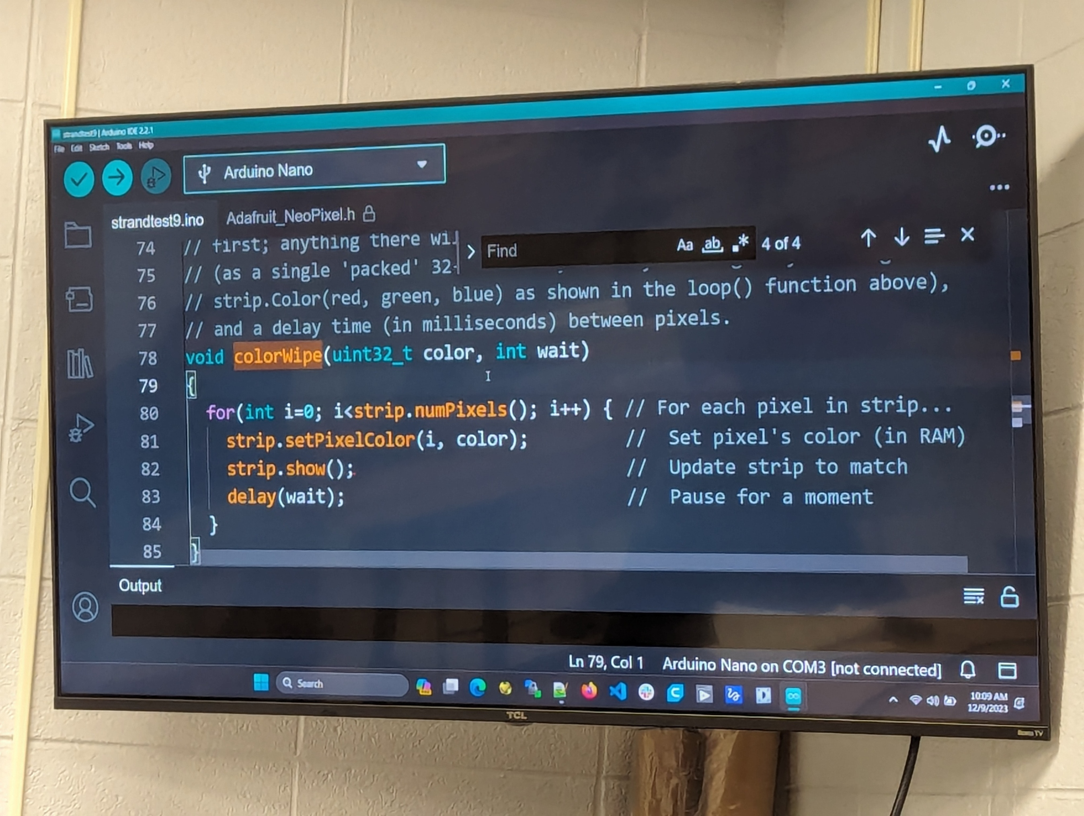
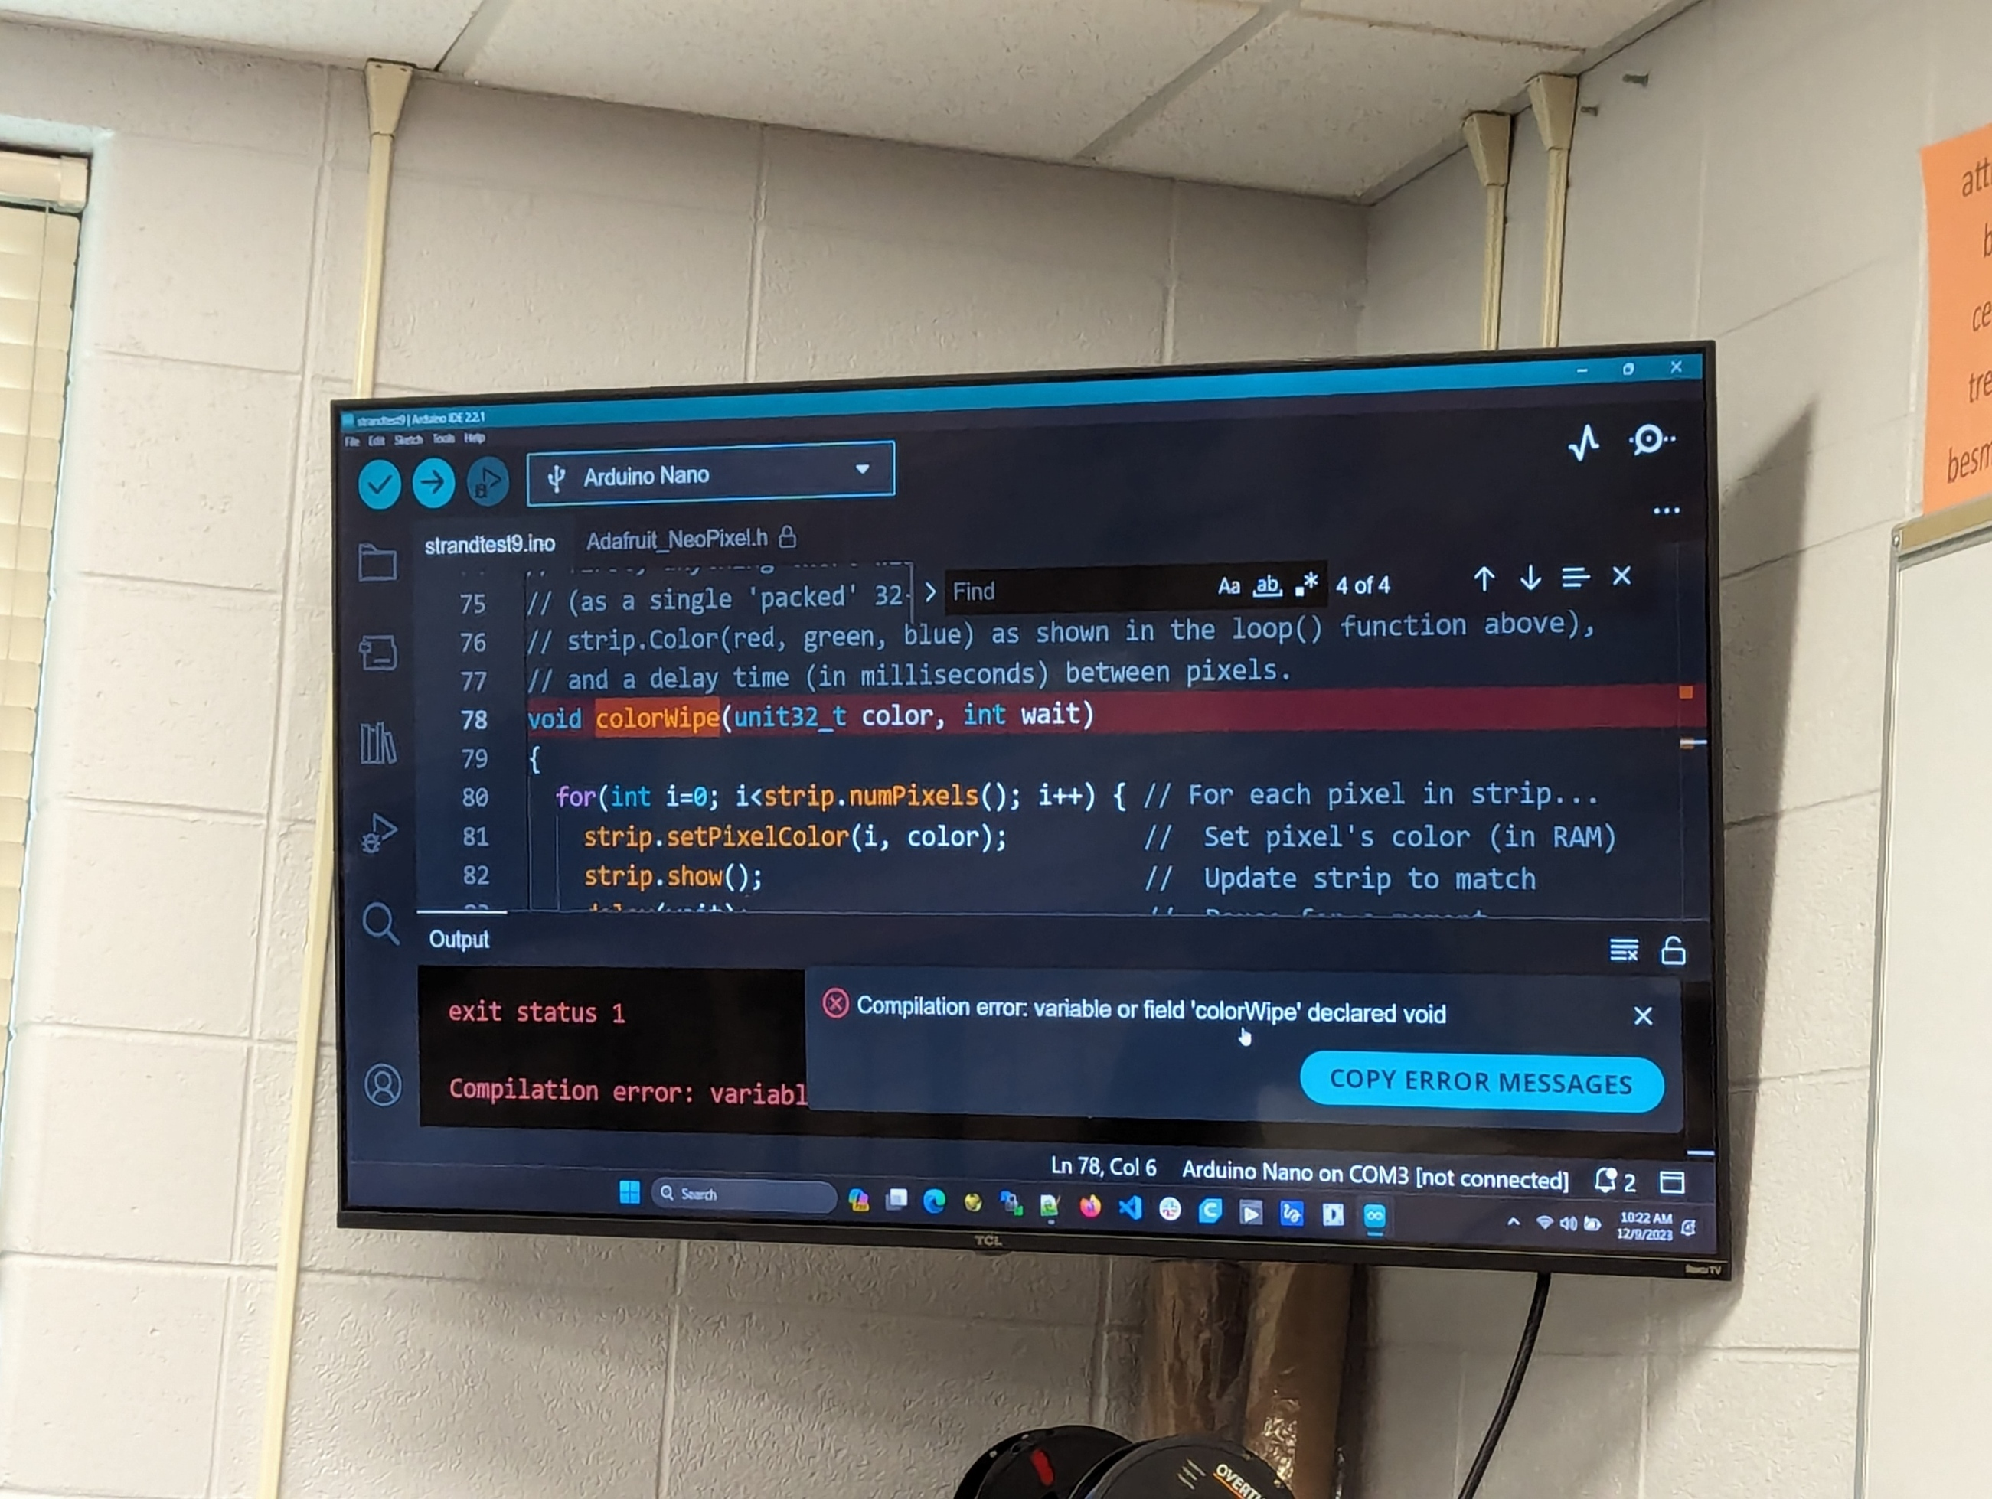
CODING TIME: Anatomy of a Sketch Part 4
Why use code LOOPS?
03
To repeat similar code with simple variations each time
Or repeat for a certain number of times
Or repeat until a certain condition is met)
To be more efficient, take up less space and simplify maintenance.
Step 3.2 (Continued)
Declare the FOR loop and the variable that will be monitored (in this case “i” for a simple index variable)
Create your own copy of the sample program!
Some more lessons – FOR Loops and usability tips
Keep variable names simple yet descriptive (these basic indexes can be as simple as i/j/k/x but typically are a bit more meaningful)
Quickly navigate between TAB views of the files you have been working on
Set the initial condition for the variable (in this case = zero)
Then set the condition during which the loop should continue (in this case while the index variable (i) is less than the value that we’ve defined for the number of pixels in our LED strip)
Then use postfix operators to tell the code how to increment the variable for each loop
(in this case adding 1 to the index value)
i++ means add one
i– means subtract one
Tip: some coding language start counting at 1, others use zero as the first number. This is called Base 0 vs Base 1. Arduino uses Base 0. If your loop repeats one time more or less than expected, you may have hit a fencepost error (see glossary)
Click on one bracket (such as the opening bracket)
& the system will automatically highlight it’s corresponding matching bracket (such as the closing bracket from that pair)
Delay a built in Arduino function that tells the Arduino to wait for a set # of milliseconds before it does the next step

Slide 13

COMPILE / VERIFY
04
Why do we Verify?
Step 4.1
Purpose #1: Required for translation of your ‘user readable’ code into the binary (computer executable) file that ultimately will be send to (loaded to) hardware such as a executable robot or an Arduino board.
Purpose #2: This step is also extremely useful during development when you want to catch and fix any coding mistakes before proceeding to upload the code to the actual hardware.
Note, the verify process does not
upload this compiled binary to the Arduino board. It only ensures that your code compiles correctly into an executable file without any errors.
Compile / Verify
Click on the verify tool (the checkbox in the top menu bar of the Arduino IDE interface) to Verify (a/k/a Compile) your code
This triggers the following process
Compiles your Arduino sketch (i.e., your code) into an executable binary file
Checks for syntax errors in your code.
Look for items highlighted in different
colors (pointing you towards issues)
Generates the compiled output (the .hex file) that corresponds to your sketch.
VERIFY

Slide 14
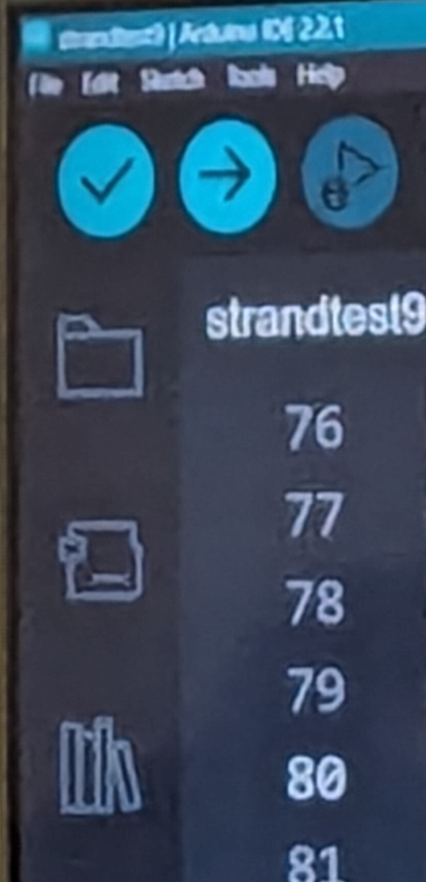

Troubleshooting Verify … also known as Why won’t it compile!!!
When working with computer code, you might encounter various errors during the compilation process. Let’s explore some of the most common causes:
1
Computers do what you tell them to. Unfortunately.
Which means that any inaccuracy in your code’s syntax or structure can cause it to fail.
Common syntax mistakes include:
Missing semicolons at the end of a line
Missing or incorrect bracket use (parentheses)
Mismatched or missing variables or variable names
Errors with capitalization (remember some things like type are case-sensitive)
HOW TO FIX: Carefully review your code for typos and syntax issues.
2
External Libraries save you time – IF you install & call them properly!
If you’re using external libraries, ensure they’re correctly installed.
Also ensure the names used in your code EXACTLY match
If a library is duplicating names you already use (such as containing a function with a name that you already call a different function), you’ll need to locate and replace the conflicting names
HOW TO FIX: Add any missing libraries from the left LIBRARY menu.
Note: you have to be on the network to install libraries.
Verify that library names installed match the ones in your code;
Resolve any duplicates by editing names.
3
Undefined Variables or Functions!
Ensure all variables and functions are declared before use.
HOW TO FIX: Check for typos or missing declarations
Pro Tip: When in doubt – Look it up! Internet references explain how things work, what functions and methods are available, what parameters and syntax to use, etc.
Remember, debugging is part of the learning process.
It can be hard but don’t get discouraged—each error brings you closer to mastering programming. We’ve all been there!

Slide 15
SEND
Difference between Verify & Send (Upload)?
05
While verify is primarily sed for checking code correctness, the “Upload” button combines verification and the actual uploading to the Arduino board.
Step 5.1
Send
When to use Verify Only:
During the early stages of writing a sketch, you might encounter compiler errors.
Using the verify button allows you to work through these errors without uploading the code to the board.
Additionally, the verify process doesn’t require an Arduino board to be connected, which can be helpful when you’re just writing and testing code on your computer.
Send/Upload takes it one step further:
Finally, using the upload button as the final step ensures that you’re working with the latest versions of included files and core libraries, as it performs a fresh compile.
The generated output file is then physically transmitted to the board.
Click on the upload tool (the arrow in the top menu bar of the Arduino IDE interface) to Send (a/k/a Upload) your code.
For this project – it sends the code to the Arduino board
This triggers the following process to not only compile but also upload to the board
Compiles your Arduino sketch (just like the verify process) into an executable binary file
Checks for syntax errors in your code.
Generates the compiled output (the .hex file) that corresponds to your sketch.
Uploads the binary file to the connected Arduino board.
SEND

Slide 16
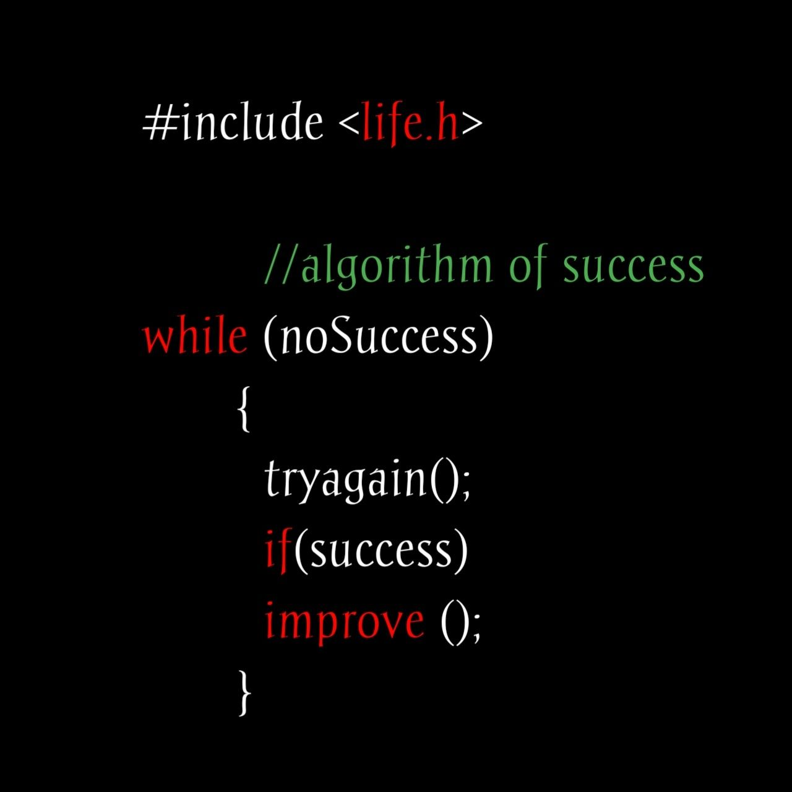
ENJOY
06
x
Step 6.1
Enjoy!
If you have been successful in the coding, your lights will start flashing according to the programmed code.
If there were errors in your code, you will need to triage and debug (see steps listed during the VERIFY step). Keep trying!!
Congratulations!

Slide 17
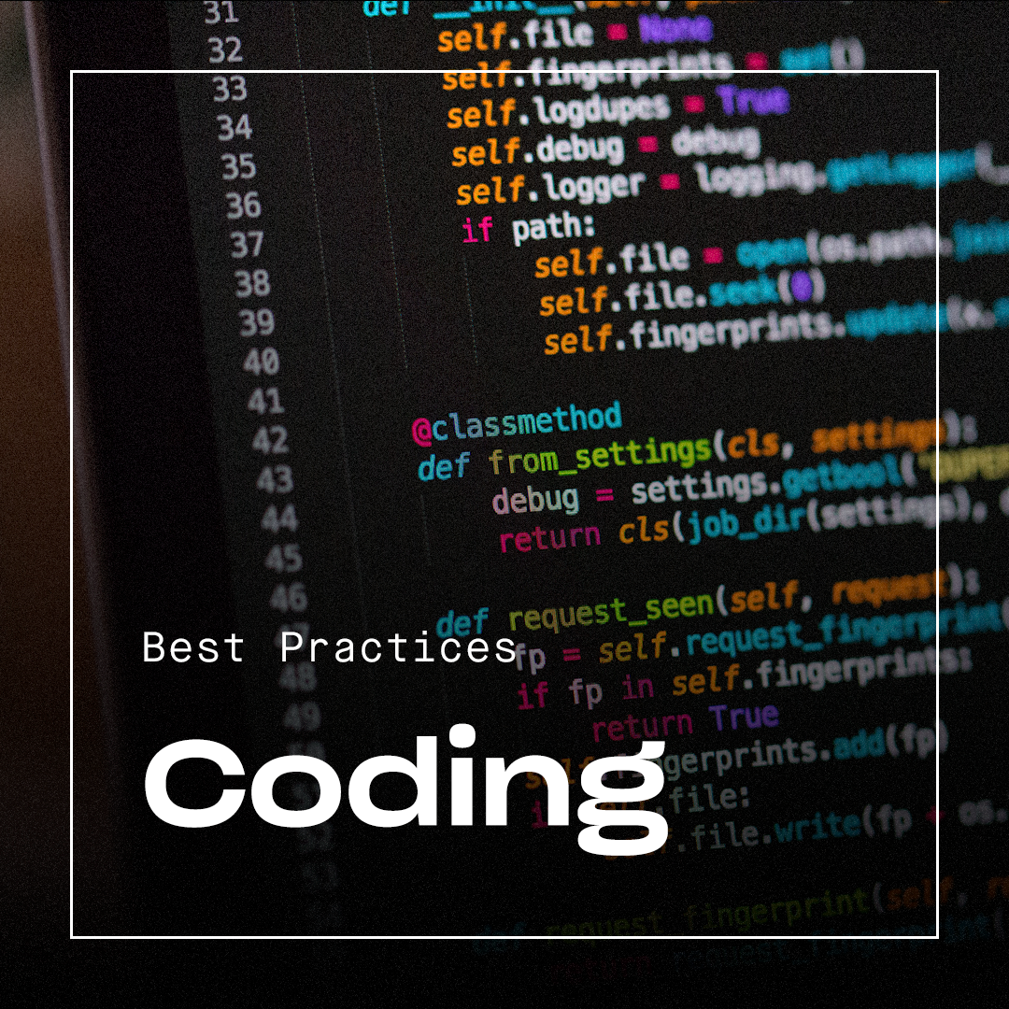
Tips & Best Practices

Slide 18


Coding Tips & Best Practices
Take advantage of these tips & best practices to help you grow as a programmer.
They will help your code be more readable to your teammates & save you hours in coding & debugging!
COMMENTS
Make them BRIEF & CLEAR, but sufficiently descriptive for someone to understand a year later
// - for a single row comment
/* to start a multi-row comment and then */ at the end of the final line of the comment to close it
NAMING CONVENTIONS
Make them CLEAR & DESCRIPTIVE
Use CamelBack case to help with legibility (see glossary)
BE PRECISE WITH YOUR FORMAT & SYNTAX!
Remember the semicolon (;) at the end of EACH line
Know the names & purposes of the different types of BRACKETS
Curly Brackets vs Square Brackets vs Angle Brackets
Create both the opening & closing bracket at the same time (then fill in the content in the middle)
Lining up the related opening and closing brackets in the same column make it easier to read and troubleshoot
Selecting one bracket in a pair will also highlight the matching bracket
Helpful in debagging to find missing brackets
Use indents (spaces or tabs) and blank rows to increase readability of your code
For blocks of similar code, copy & paste the first block you create and get working.
Then simply change the nuances/details in the 2nd, 3rd, etc…
Then update your comments accordingly on the subsequent blocks to indicate the purpose of each block

Slide 19

Handy #1259 Code Team References!

Slide 20
Other Team References
Technical Resources | FIRST (firstinspires.org)
01
Control System and Programming Documentation (WPLib)
Resources to help with wiring and programming your robot.
02
Programming 101
This resource covers the basics of programming in FIRST Robotics Competition. It covers C++, Java/Kotlin, and LabVIEW.
03
04
05

Slide 21

Other learning sites & ideas to spark your brains!

Slide 22
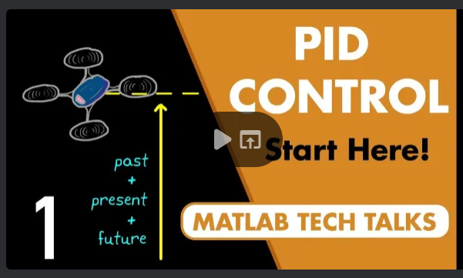
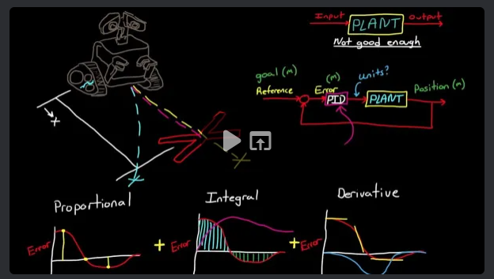

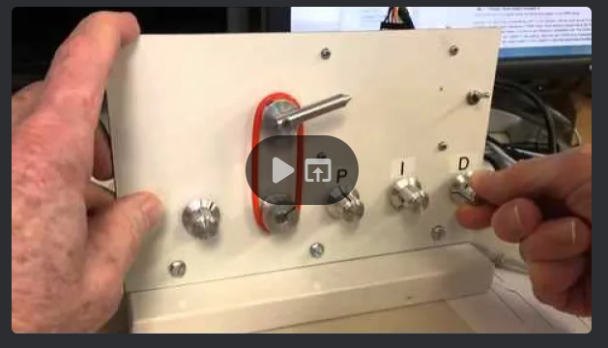
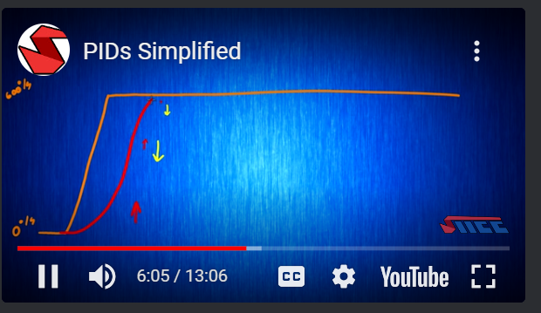
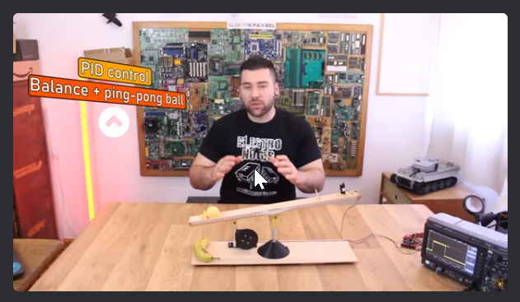


01
What Is PID Control? | Understanding PID Control, Part 1
02
PID Control
A brief introduction
03
PID demo
04
PIDs Simplified
05
PID Balance+Ball | full explanation & tuning
06
Hackaday website (a mix of electronics, mechanical, and other projects)
07
Jeremy Fielding's channel
(general mechanical & robotics)

Slide 23
#1259 - CODE TEAM GLOSSARY
A B C D E F G H I J K L M N O P Q R S T U V W X Y Z

Slide 24
A
ADDRESSABLE LIGHTS | LED light strips where each individual light can be programmatically interacted with separately (setting colors, brightness, sequence, etc.)
ARDUINO | x
ARGUMENT | An argument is a way to provide more information to a function. The function can then use that information as it runs, like a variable (For more info on variables, see below.)
AUTONOMOUS | Autonomous robot, like a self-driving car, and delivery bot are all terms used to describe robots that navigate their environments using sensors with little to no human interaction.
Back

Slide 25
B
BINARY | A binary number is a computer's way to represent information. Computers process millions of 1's and 0's a minute using different rules to interpret them as numbers, letters, operators, and everything else put into a computer.
BIT | The individual 1's and 0's you see in binary
BRACKETS | Brackets, or braces, are a syntactic construct in many programming languages. They are typically used to denote programming language constructs such as blocks, function calls or array subscripts. There are 4 common formats:
[ ] – square brackets
( ) - brackets
{ } – curly brackets
< > - angle brackets
Back

Slide 26
C
C++ | C++ is a low-level yet versatile programming language
CAMEL CASE | Variables should be named using camel case, meaning the first word of the name is lowercase and each new word after that is capitalized. It's called camel case because when it was originally written as CamelCase, the capital Cs look like the humps on a camel. iPhone, eBay, YouTube are real-world examples of camel casing!
CODING | Coding is how people create instructions for computers to follow. Just like people speak different languages, so do programs. For instance, we may build robot code with C++ while Minecraft was built with Java.
CODING LANGUAGES | Computers use coding languages to understand what people want them to do. Just like how people communicate with each other in English or Japanese, people communicate with computers in languages like C++ or Java. Examples include: C++, Java, JavaScript, and Python
Back
More

Slide 27
C
COMMENTS | Human-friendly documentation of what the code is doing
COMPILER | What takes the code and turns it into something the robot understands; ignores comments and blank rows
COMPUTER PROGRAM | A computer program is a group of instructions given to a computer to be processed. These instructions are typically used to solve a problem, or make long problems for humans shorter and easier.
CONDITIONAL STATEMENTS | Conditional statements evaluate to true or false. Use them to print information or move programs forward in different situations. Includes IF … THEN … ELSE …. Scenarios.
Back

Slide 28
C
CLASS | Part of an object-oriented programming language. An abstract blueprint that creates more specific, concrete objects. Classes often represent broad categories, like that share attributes (such as ‘Students’). These classes define what attributes an instance of this type will have, like student name and hair color, but not the value of those attributes for a specific object.
- Classes can also contain functions called methods that are available only to objects of that type. These functions are defined within the class and perform some action helpful to that specific object type.
Back

Slide 29
D
D* | x
Back

Slide 30
E
ELSE STATEMENTS | Else statements are used to do something else when the condition in the if statement isn't true; and if ‘ELSE IF’ statements were used – none of those were true either.
ELSE IF STATEMENTS | Use an else if statement to do something when the if statement's condition isn't true but before the else statement. Else if statements also check a specific condition.
Back

Slide 31
F
FENCEPOST ERROR | a specific type of ‘Off-By-One” error. Often occurs in computer programming where a loop executes one too many or one too few times. Can be caused by zero-based numbering (where you expected the count to start at 1, but your coding language actually started at zero) or by incorrect use of operators such as <= rather than just <.
FILE EXTENSION | such as .io for Arduino programming file, or .xls for an Excel file, or .txt for a Text file.
FOR LOOPS | For loops allow you to run a block of code repeatedly, just like while loops. However, for loops run a block of code a set number of times. (Remember, while loops run an unknown or unspecified amount of times.)
FUNCTIONS | A function is a block of code that can be referenced by name to run the code it contains. Also called methods.
Back

Slide 32
G
G* | x
Back

Slide 33
H
H* | x
Back

Slide 34
I
IF STATEMENTS | An if statement runs a block of code based on whether or not a condition is true.
INCLUDE | the first statement in the program code. Allows you to reuse other developer’s work, rather than recreating. Ex: for the Arduino light project we borrowed the library code from DataFruit. Think of it as cut and paste – so whatever logic is defined in that included from that source file can run in our code (without us having to recreate it).
INCREMENT & DECREMENT OPERATIONS | Increment (++) and decrement (--) operators add or subtract one from the numerical value of the variable they're adjacent to. They're useful for situations when you only want to change a value by exactly one.
INPUT | Input is any interaction from the user or other device into the program. In video games, this includes using the keyboard to move or using the mouse; could also include a signal from a sensor on a robot.
Back

Slide 35
I
Integrated Development Environment (IDE) | Software where you type your code and run your programs. Basically, an IDE is software that makes coding simpler.
Back

Slide 36
J
J* | x
Back

Slide 37
K
K*
Back

Slide 38
L
LIBRARY | A library is a collection of code made by other programmers for you to import and use.
LOOPS | Loops check a condition and then run a code block. The loop will continue to check and run until a specified condition is reached.
Back

Slide 39
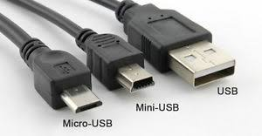
M
MINI-USB CABLE | The older style type of USB cable connector used to connect the Arduino board to the laptop. Fatter than the new Micro-USB connectors.
Back

Slide 40
N
NeoPixel | DataFruits name for the addressable LED lights we use in our robots and projects
Back

Slide 41
O
Object Oriented Language | A programming paradigm in computer science that relies on the concept of classes and objects. Used to structure a software program into simple, reusable pieces of code blueprints (usually called classes), which are used to create individual instances of objects.
There are many object-oriented programming languages, including JavaScript, C++, Java, and Python.
Back

Slide 42
P
Postfix Operator | Returns the value of the variable first and then either increments (++) or decrements (--) that value; typically takes the format of VarName++ or VarName – vs a prefix operator that takes the format of ++VarName or - - VarName. We typically will use Postfix operators unless instructed otherwise.
POTENTIOMETER | A potentiometer is a three-terminal resistor with a sliding or rotating contact that forms an adjustable voltage divider
Prefix Operator | Increments (++) or decrements (--) the variable before returning it; typically takes the format of ++VarName or - - VarName
PROGRAMMING | Programming is creating a set of instructions for a computer to follow. Think of it like a language between people and machines. Programming is most commonly used to make long and repetitive tasks quick and easy.
Back
More

Slide 43
P
PROGRAMMING LANGUAGES | Programmers use programming languages to communicate instructions to computers. These languages include Python, C++, Java, JavaScript, and more.
PYTHON | Python is a programming language that’s currently becoming more and more powerful with every new library added to its collection. It handles everything from web development and game design, to machine learning and AI. Python is known for having syntax that's simpler and easier to write than many other languages like Java and C++.
Back

Slide 44
Q
Q* | x
Back

Slide 45
R
RGB | Red Green Blue – the standard abbreviations for the main LED color types
Back

Slide 46
S
SCRIPTS | In programming, a series of scripts, or sets of steps, are written for a computer to follow. Computers process the steps line-by-line from top to bottom. Each step is created by writing a statement.
STATEMENT | The way you tell a computer to perform an action is by giving it instructions or writing statements to explain a desired action. Again, it’s similar to writing sentences in English, but with words, numbers, and punctuation added depending on the programming language.
STRINGS | Variables can hold data besides numbers, including words. Programmers refer to variables holding words or mixtures of letters and numbers, etc. as strings.
Back
More

Slide 47
S
SETPIXELCOLOR | Name of the function for setting the color of Arduino pixels
Back

Slide 48
T
T* | x
Back

Slide 49
U
Uint (Unsigned Integer) | x
Back

Slide 50
V
VARIABLE | A variable is a container that holds a single number, word, or other information that you can use throughout a program. A variable is like a chest you can fill with different values. You name the chests so you can find them later. Variables have three parts: type, name, and value.
VARIABLE TYPES | Once a variable is declared, a variable type is specified. Basic variable types include: string (words and phrases), char (short for “character;” a single letter or symbol you can type), int (short for “integer;” for whole numbers), double or float (for decimal numbers), and bool (short for “boolean;” for true or false values).
VERIFY | In the context of Arduino programming, the term “verify” is used to perform a specific action within the Arduino Integrated Development Environment (IDE); specifically to compile the code, check for syntax or structural errors and generate compiled output for review.
VOID | The return type of a function; specifying that this function doesn’t return anything – it just runs and executes it logic.
Back

Slide 51
W
WHILE LOOPS | While loops are set up just like if statements. They check for a condition and run the code in them until the condition is no longer true. A while loop will run forever (until the condition is false).
Back

Slide 52
X
X* | x
Back

Slide 53
Y
Y* | x
Back

Slide 54
Z
Z* | x
Back

